Slide 1




Options ‘26
What is an Ebacc?
How can I help my child?
GCSEs Vs. Technical Awards?
How do number grades work at GCSE?
Curriculum Presentation
Mr C Foulk
Assistant Head Teacher
Curriculum

Slide 2

Options Evening
FERNWD Tutor Groups (Pathway 1 & 2)
6.00 – 6.15pm: Market Place with Subjects
6.15 – 6.45pm: (Hall) Curriculum Presentation
6.45 – 7.15pm: Market Place with subjects in:
Dining Hall, MFL & Drama
SHCMTY Tutor Groups (Pathway 1 & 2)
6.20 – 7.00pm: Market Place with Subjects
7.00 – 7.30pm: (Hall) Curriculum Presentation
7.30 – 7:45pm: Market Place with subjects in:
Dining Hall, MFL & Drama
All Tutor Groups (Pathway 3 & 4)
6.15 – 6.45pm: (Study Support) Curriculum Presentation
Mrs Steans
6.45 – 7.15pm: Market Place with subjects in:
Dining Hall, MFL & Drama

Slide 3



Why GCSE Options Matter
Shape students experience over the next two years
Students who enjoy their subjects feel more confident, engaged, successful
Perspective:
Employees, colleges and universities are far more interested in how well students do than the precise combination of subjects they choose at GCSE.

Slide 4








Education & Employment
Qualifications enable you ‘entry’ to further study, and also enable employers to work out which candidates to give a job to.
GCSE Certificates
ENGLISH
GRADE 3
HISTORY
GRADE 6
ENGLISH
GRADE 3
ENGLISH
GRADE 9
ENGLISH
GRADE 4
ENGLISH
GRADE 6
JOHN SMITH
AUGUST 2027
A-Level History
Entry Requirements:
GCSE Maths: Grade 4
GCSE English: Grade 5
GCSE History: Grade 5

Slide 5




Gaining a Qualification
There are several ways to gain a qualification:
Academic
Study
Examinations
Exams last 1–2.5 hours, taken at the end of Year 11, usually in the sports hall, and marked by national exam boards.
NEA
Project work completed in class, often lasting weeks or months, with limited teacher support.
Examination
Examination
GCSE
+
50%
50%
Examination
Examination
Examination
GCSE
+
+
33%
33%
33%
Examination
Non-Examined Assessment (coursework)
GCSE
+
50%
50%
Examination
NEA
NEA
GCSE
+
+
50%
35%
15%

Slide 6





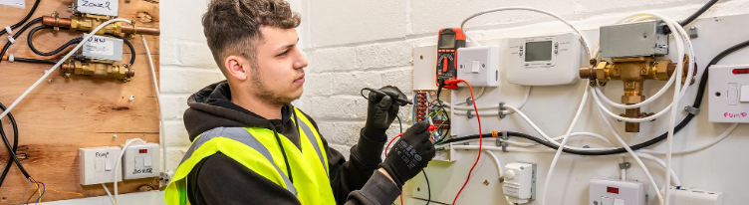

Academic vs. Vocational
There are many ways to gain a qualification:
Academic
Study
Examination
Examination
NEA
+
(+)
e.g. GCSEs & A-levels
Technical
& Vocational
Examination
Practical Assessment
+
e.g. OCR National & T-Levels
Classroom Learning
Apprenticeship
+
On the job training

Slide 7


Qualifications Framework
Academic
Vocational & Technical
Apprenticeship
LEVEL
8
Doctorate
PhD
LEVEL
7
Masters Degree
MS, MSc, PGCE
LEVEL
6
Higher Education
University
e.g. University of Nottingham
LEVEL
5
Bachelor
Degree
BA, BSc, BEd
Higher National Diploma
Foundation
Degree
FdA, FdSc, FdAr
Higher
Apprenticeship
LEVEL
4
Higher National Certificate
Earliest possible exit from education
20+ hours working +
Part time education
Further Education
Key Stage 5
College & Sixth Form
e.g. Bilborough College
LEVEL
3
A-Level
Grades A*-E
L3 Award
L3 Certificate
L3 Diploma
(BTEC)
T – Level
Worth 3 x
A-levels
Advanced
Apprenticeship
AS
Level
L3 Award
L3 Certificate
L3 Diploma
(BTEC)
LEVEL
2
GCSE
Grades 4-9
L2 Award/Certificate/Diploma
Technical Awards
Secondary Education
Key Stage 4
e.g. The Fernwood School
LEVEL
1
GCSE
Grades 1-3
L1 Award/Certificate/Diploma
Technical Awards
Secondary Education
Key Stage 3: National Curriculum
e.g. The Fernwood School

Slide 8
Grading Structure
Before 2017
A* A
B C
D E F G
Academic
Vocational & Technical
Grade |  | Level
9 |  | L2 Distinction *
8
7 |  | L2 Distinction
6 |  | L2 Merit
5
4 |  | L2 Pass
3 |  | Level 1 Scheme
2
1
22% of students
nationally
LEVEL
2
68% of students
nationally
STRONG PASS
STANDARD PASS
32% of students
nationally
LEVEL
1

Slide 9

Core Curriculum- (What everyone studies)
There are some subjects which, because of their importance for life and the world of work, are considered to be essential for all students.
Core Curriculum Subjects:
English (Language and Literature),
Combined science,
Mathematics,
Religious education,
Physical education
Personal development (includes careers advice, information, and guidance, plus preparation for post 16 applications and work experience)

Slide 10


Options
Choice
High-quality curriculum with academic rigour
Not an ‘exam factory’
Breadth & balance
Love, enthusiasm and interest are vital
Blend of both traditional GCSEs as well as practical,
vocational & technical awards.
22 different courses are available across all the pathways.
Pathway One
These students will have the option of four choices.
Pathway Two
These students will have the option of three choices.
To ‘pass’ English and Maths at GCSE, you require a grade 4, or will be required to re-sit during key stage 5 (college). Their English and Maths teachers think this group will benefit from supplementary English & Maths curriculum time in order to have a higher chance to secure a grade 4+
1
2

Slide 11

Science
We offer two different versions of science to suit different learners. As a minimum all students will study combined science (2 GCSE’s) within the compulsory core curriculum.
However, you can also choose to opt triple science (3 GCSE’s) which will take up one of your option choices and provides you with a separate GCSE for each science.
Combined Science | These are separate courses which cover an equal mix of all the three sciences above, but there is less content. It leads to a double award GCSE
Triple Science | Separate courses in biology, chemistry and physics which each lead to a separate GCSE qualification. This course is academic and aimed at those with a keen interest in science or those pursuing science beyond Fernwood.
1 x GCSE SCIENCE
+
1 x GCSE SCIENCE
1 x GCSE PHYSICS
+
1 x GCSE BIOLOGY
+
1 x GCSE CHEMISTRY

Slide 12
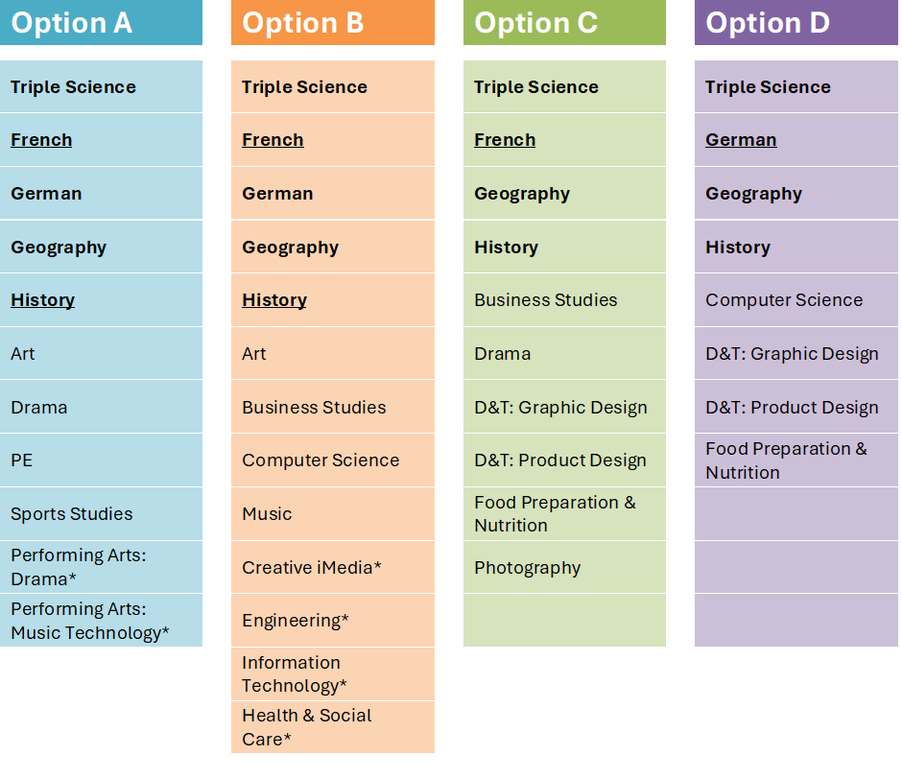
Pathway One Options
Choose one subject from each option block,
and then a reserve choice (from any block).
2 of your 4 choices should be from the subjects in bold and a further two open choices.
Most children get all their options.
You are more likely to get your Option A choice.
You are less likely to get your Option D choice.
Let’s assume I wish to do Computer Science more than Geography. I need to get Computing into an earlier option.
Reserve: Drama

Slide 13
Pathway Two Options
one subject from each option block, and then a reserve choice (from any block).
1 of your 3 options must be an underlined subject.
Option A |  | Option B |  | Option C
Triple Science |  | Triple Science |  | French
French |  | French |  | German
German |  | German |  | Geography
Geography |  | Geography |  | History
History |  | History |  | Business Studies
Art |  | Art |  | Drama
PE |  | Music |  | D&T: Graphic Design
Business Studies |  | Creative iMedia* |  | D&T: Product Design
Sports Studies* |  | Engineering* |  | Food Preparation & Nutrition
Performing Arts: Drama* |  | Health & Social Care* |  | Photography
Performing Arts: Music Technology* |  | Information Technology*
Drama
Most children get all their options.
You are more likely to get your Option A choice.
You are less likely to get your Option D choice.
Let’s assume I wish to do Computer Science more than Geography. I need to get Computing into an earlier option.
Reserve:
iMedia

Slide 14
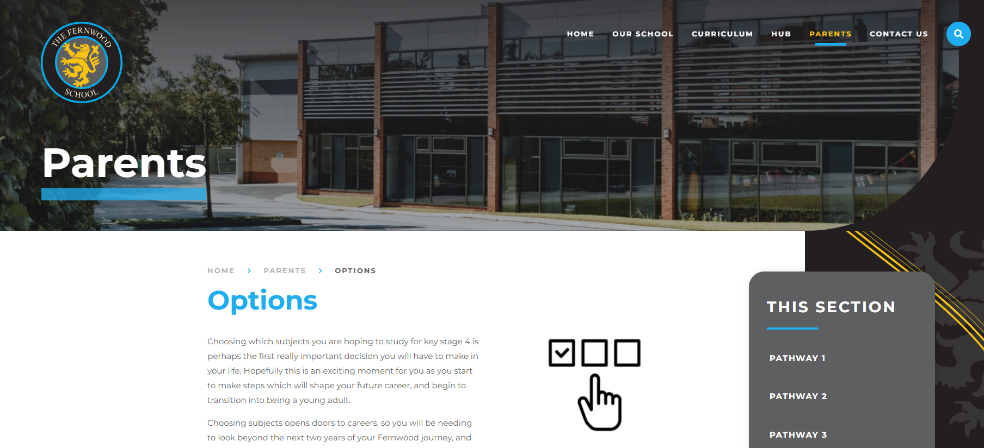
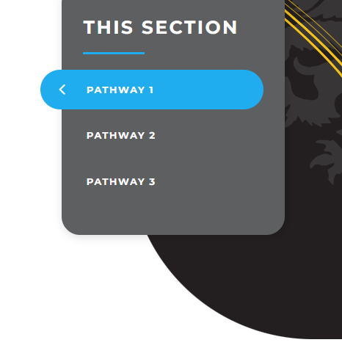
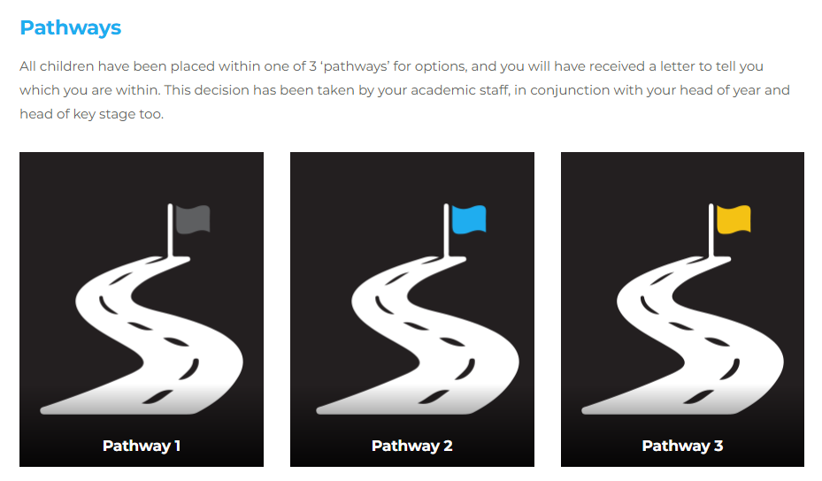



www.fernwood.school/parents/options
All the information available via our website.
Including:
videos from most subjects,
written information that I encourage you to read thoroughly.
TIP: You might be quite surprised during year 10 as to what studying a specific subject actually entails, in comparison to what they imagined it would involve.

Slide 15
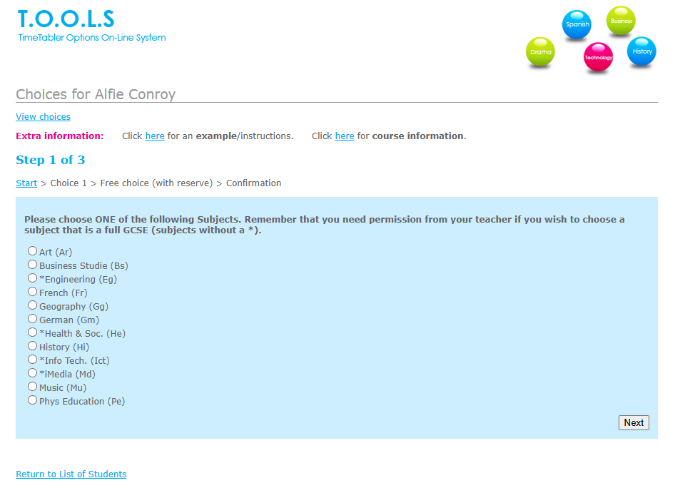

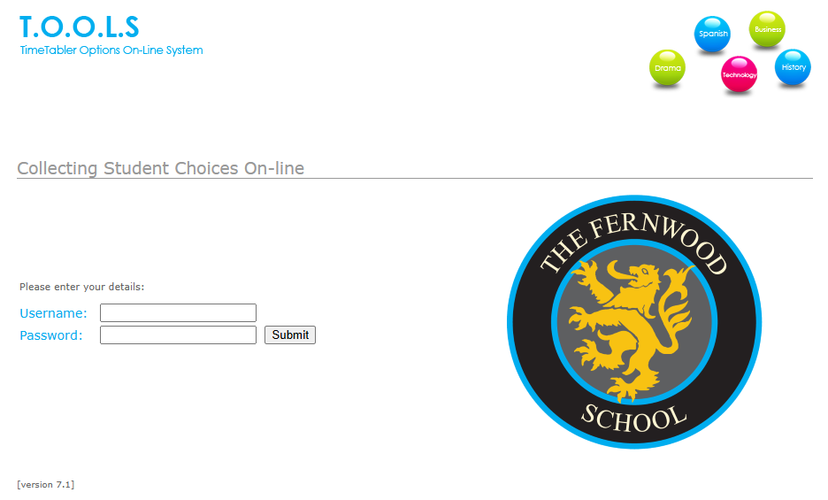
Entering Options
Tomorrow, you’ll receive an email with a link to the online options system.
Log in using your username and PIN.
Select your preferred subject for each of the 3–4 option blocks.
You’re more likely to be allocated a subject if it’s chosen in Block A than in Blocks C or D.

Slide 16

FAQ
Frequently Asked Questions
Is it first come, first served?
No – it’s order of preference by the deadline
Can I change my mind?
Yes, so long as it is before the deadline.
Vocational qualifications aren’t viewed as well as GCSEs.
  No, they’re great qualifications, and have equal worth
When will I find out my options?
  In mid-June
Will I get the options I have chosen?
  Not necessarily, we aim to give you what you want but sometimes a course could be over-subscribed or may clash with something else you have picked when it is timetabled. That’s why we ask for a reserve choice
How do I decide?
Pick subjects you enjoy, are good at, and will stay motivated with for two years.
What if I don’t know my future career yet?
That’s normal. A broad range of subjects keeps your options open.
Are some GCSEs harder than others?
All GCSEs are similar in difficulty but suit different skills and strengths.
Do colleges or employers care about my choices?
They mainly look at strong grades across a range of subjects

Slide 17

Deadline: Friday 27th February
Key message: You are supported.
Tutors, teachers, and parents can help.
No one expects them to have their whole life planned. If in doubt choose a broad balance of subjects.
TOP TIPS in choosing:
Do I enjoy this subject?
Am I reasonably good at it?
Do I like how it’s assessed?
Could it be useful in the future?
What NOT to base choices on:
Friends choosing it
Who teaches it
Thinking something will be “easy”
Remember: Enjoyment + effort = success

Slide 18

Deadline:
Options Website
Friday 27th February 2026
Enjoy the process, and remember, whatever you choose, make sure you enjoy it!
If you enjoy something, you are far, far more likely to be brilliant at it!

